Slide 1

CODER HOUSE PROYECTO BASES DE DATOS
IBARRA SERGIO
MARCH 2023

Slide 2
DATASET: Se decidió usar un dataset de Kaggle con información histórica de carreras de la formula 1
Se extrajo información acerca de cada Carrera en el ciruito professional de formula 1 desde el año 2009 hasta el 2022.
Esta información está dividida en muchas tablas tales como: circuits. cricuits_results , constructor_standings , constructors, driver_standings, drivers, lap_times, pin_stops, qualifiying, races, results, seasons, sprint_results, status.
Notes:
Seasonality, trend and noise in time series data | Python (datacamp.com)

Slide 3
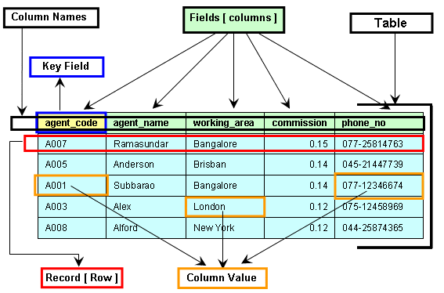
Definiendo las distintas entidades y sus campos

Slide 4
Se decidió usar un dataset de Kaggle con información histórica de carreras de la formula 1
Table: Constructors
Field | Type of Data
constructurID (PK) | Int
constructurRef | varchar
name | Varchar
Nationality | Varchar
utl | Varchar
Table: Circuits
Field | Type of Data
circuitID (PK) | Int
circuitRef | varchar
name | Varchar
location | Varchar
Country | Varchar
lat | Float
lng | Float
alt | Float
url | Varchar
Table: Constructors_results
Field | Type of Data
constructorResultsId (PK) | Int
raceId (FK on Race(raceID)) | Int
constructorId (FK on Constructors(constructorId)) | Int
Points | Int
Status | Varchar
Table: Constructors_stadings
Field | Type of Data
constructorStandingsId (PK) | Int
raceId (FK on Race(raceID)) | Int
constructorId (FK on Constructors(constructorId)) | Int
Points | Int
Position | Int
PositionText | Int
Wins | Int
Notes:
Seasonality, trend and noise in time series data | Python (datacamp.com)

Slide 5
Se decidió usar un dataset de Kaggle con información histórica de carreras de la formula 1
Table: Drivers
Field | Type of Data
driverId (PK) | Int
driverRef | varchar
number | Varchar
Code | Varchar
Forename | Varchar
surname | Varchar
dob | Date
nationality | Varchar
url | Varchar
Table: Lap_times
Field | Type of Data
raceId (FK on Race(raceID)) | Int
driverId (FK on Drivers(driverID)) | Int
lap (PK) | Int
position | Int
time | Varchar
miliseconds | Int
Table: Driver_standings
Field | Type of Data
driverStandingsId(PK) | Int
raceId (FK on Race(raceID)) | Int
driverId (FK on Drivers(driverID)) | Int
Points | Int
Position | Int
PositionText | Int
Wins | Int
Table: pit_stops
Field | Type of Data
raceId (FK on Race(raceID)) | Int
driverId (FK on Drivers(driverID)) | Int
stop (PK) | Int
lap(FK on lap_times(lap)) | Int
Wins | Int
time | Varchar
duration | float
miliseconds | Int
Notes:
Seasonality, trend and noise in time series data | Python (datacamp.com)

Slide 6
Table: results
Field | Type of Data
resultID(PK) | Int
raceId (FK on Race(raceID)) | Int
driverId (FK on Drivers(driverID)) | Int
constructurID (PK) (FK on Constructor(constructorID)) | Int
number | Int
Grid | Int
position | Int
PositionText | Int
PositionOder | Int
position | Int
laps | Int
time | Varchar
miliseconds | Int
fastestLap | Int
rank | Int
fastestLapTime | Varchar
fastestLapSpeed | Float
statusId | Int
Table: races
Field | Type of Data
raceId (PK) | Int
year | Int
round | Int
circuitID (FK on Cicruits(circuitID)) | Int
name | Varchar
date | Date
time | Varchar
url | Varchar
fp1_date | Date
fp1_time | Varchar
fp2_date | Date
fp2_time | Varchar
fp3_date | Date
fp3_time | Varchar
quali_date | Date
quali_time | Varchar
sprint_date | Date
sprint_time | Varchar
Table: qualifiying
Field | Type of Data
qualifyId (PK) | Int
raceId (FK on Race(raceID)) | Int
driverId (FK on Drivers(driverID)) | Int
constructurID (FK on Constructor(constructorID)) | Int
number | Int
position | Int
q1 | Varchar
q2 | Varchar
q3 | Varchar
q4 | Varchar
Notes:
Seasonality, trend and noise in time series data | Python (datacamp.com)

Slide 7
Se decidió usar un dataset de Kaggle con información histórica de carreras de la formula 1
Table: spirnt_results
Field | Type of Data
resultId(PK) | Int
raceId (FK on Race(raceID)) | Int
driverId (FK on Drivers(driverID)) | Int
constructurID (FK on Constructor(constructorID)) | Int
number | Int
Grid | Int
position | Int
PositionText | Int
PositionOder | Int
position | Int
laps | Int
time | Varchar
miliseconds | Int
fastestLap | Int
fastestLapTime | Varchar
statusId | Int
Table: Seasons
Field | Type of Data
year | Int
url | varchar
Table: Status
Field | Type of Data
StatusID (PK) | Int
status | varchar
Notes:
Seasonality, trend and noise in time series data | Python (datacamp.com)

Slide 8
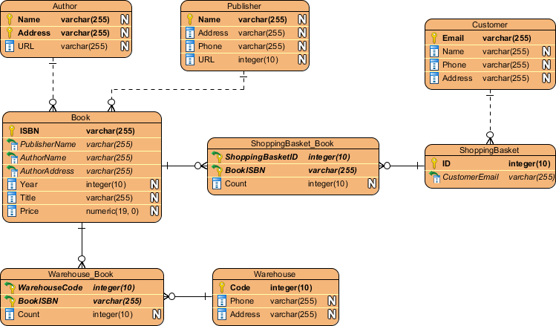
Definiendo las relaciones entre las distintas entidades

Slide 9
Se presenta la relación entre la distintas entidades de nuestra base Formula1
WIP
Notes:
Seasonality, trend and noise in time series data | Python (datacamp.com)

Slide 10
Se presenta la relación entre la distintas entidades de nuestra base Formula1
WIP
Notes:
Seasonality, trend and noise in time series data | Python (datacamp.com)

Slide 11


Slide 12
HIPOTESIS:
Se pretende analizar patrones, relaciones o tendencias en las distintas variables de estudio, por ejemplo. ¿Qué tantas veces aquel que empieza en
Notes:
Seasonality, trend and noise in time series data | Python (datacamp.com)

